Slide 1
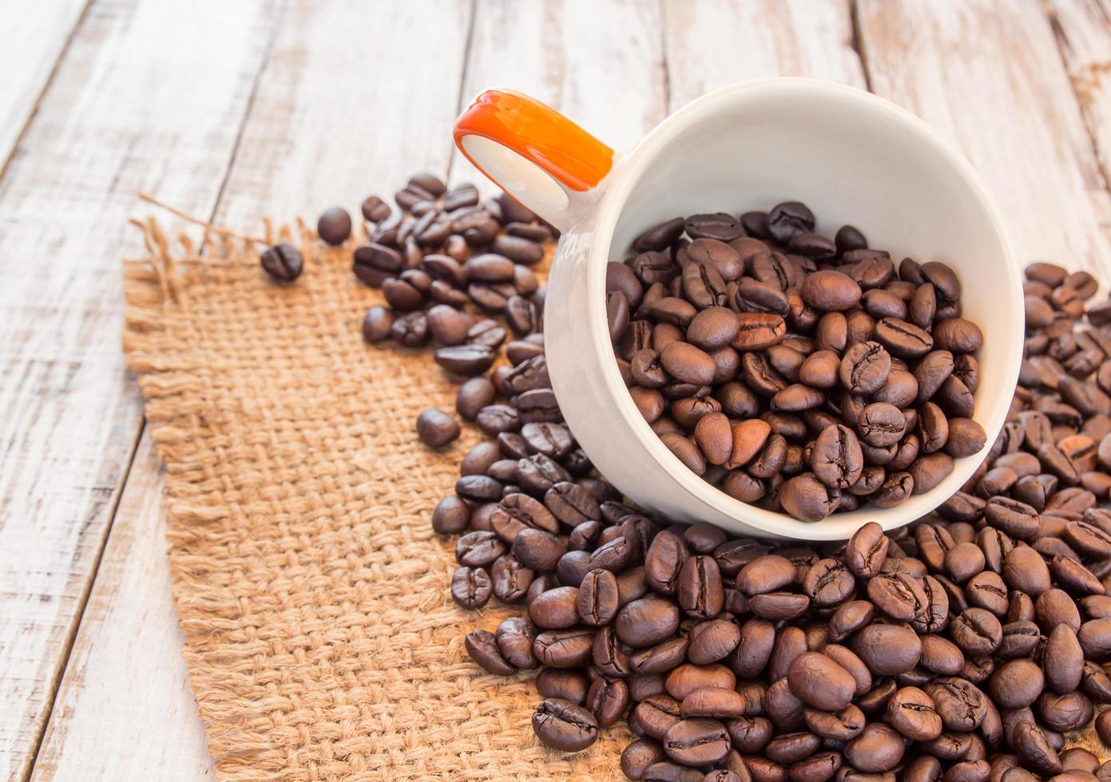
The Colombia Coffee Cultural Landscape
Presentation
My name is: Wilmer Espinosa
Course:English
Teacher: Carlos Ortega
Activity: GA2-240202501-AA2-EV02

Slide 2
The Colombia Coffee Cultural Landscape
The historical, natural and cultural richness, the love for the land and the family, the beautiful landscapes and the architecture are some of the values that make the Coffee Cultural Landscape unique

Slide 3
The Colombia Coffee Cultural Landscape
The coffee farms in Quindío are the ideal setting for lovers of rural tourism and agrotourism to experience the coffee culture first-hand and serve as a starting point to discover the other tourist sites of Quindio and thes coffee region

Slide 4
The Colombia Coffee Cultural Landscape
The coffee cultural landscape is not only nourished by coffee plantations and landscapes to obtain its worldwide recognition, but also by its charming towns that have managed to preserve the intact magic of a bygone colonial era.

Slide 5
The Colombia Coffee Cultural Landscape
The coffee cultural landscape is a magical place, there are many waterfalls, beautiful hills and many rivers. Its people are very friendly and hospitable, this land smells of coffee and magic.

